Slide 1
Final competition
By MiMaCh System - course of Intelligent Systems a.y. 21/22

Slide 2
TABLE OF CONTENTS
1
2
3
4
INTRODUCTION
OUR APPROACH
Description of the game, the environment and the agent.
Description of the adopted strategies, the choices made and our code.
APPROACH REVIEW
CONCLUSION
Description of the strengths and weakness of our approach.
Our results and conclusion.

Slide 3
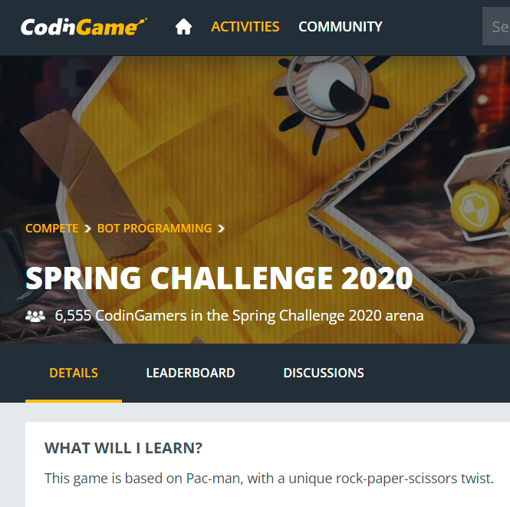
Introduction
Description of the game
CodinGame Platform
Pacman with a twist
Brief introduction to the platform
Brief description of the game

Slide 4
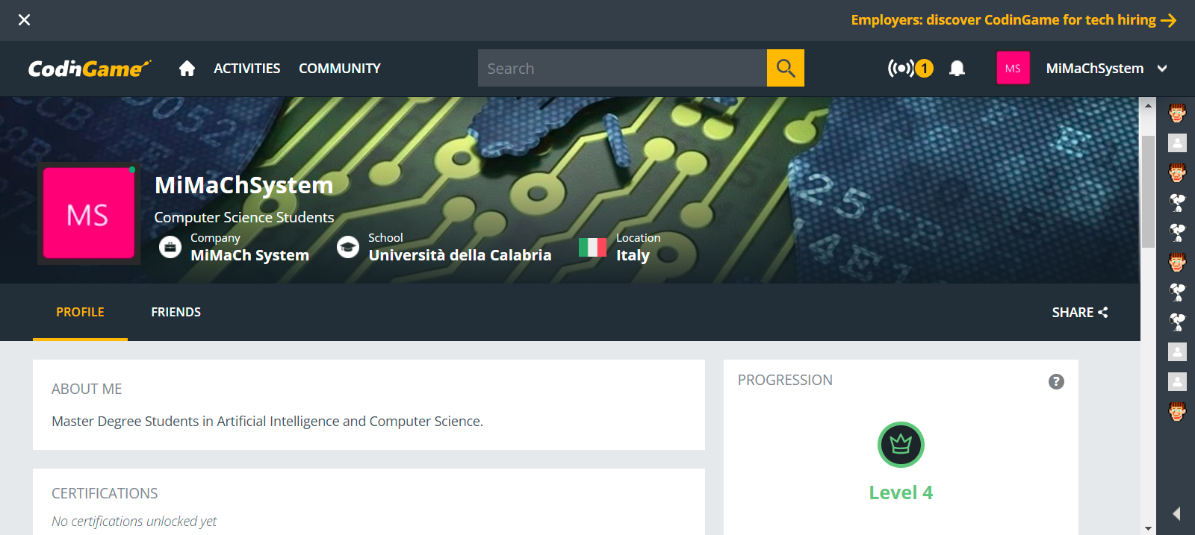
The Platform CodinGame
On CodinGame, passionate developers learn, train, chat and have tons of fun!
On the home page you can find a quick tutorial and introduction about the platform.
The goal of this platform is to let programmers keep on improving their coding skills by solving the World's most challenging problems, learn new concepts, and get inspired

Slide 5
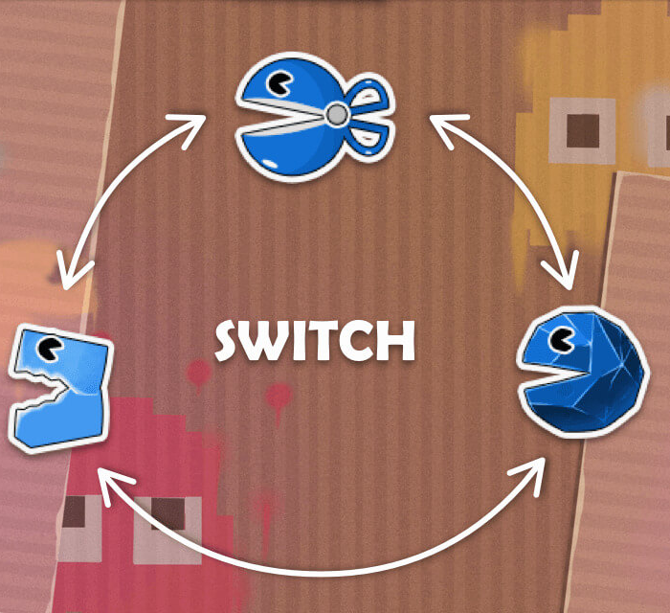
Spring Challenge 2020
This Challenge is a Pacman game but with a nice twist: pacmans can transform themselves and eat each other following the rules of the game rock-paper-scissors
It is really interesting and attracting version of the classical arcade game!
This puzzle can be solved using different topics, also studied during our lectures:
Pathfinding
Multiagent
Distances & 2D Array
It is possible to find more information on the website Practice AI, Pathfinding and Multi-agent with "Spring Challenge 2020"

Slide 6


Main Rules
Target
The game is played on a grid, composed by walls and floors.
Each player controls a team of pacs.
The map is filled with pellets (1 point) and super-pellets (10 points).
The game stops when there are no enough pellets to change the final result or after 200 turns.
Eat more pellets than your opponent!
Avoid getting killed!
The winner is the player with the highest score, regardless of the amount of surviving pacs.

Slide 7
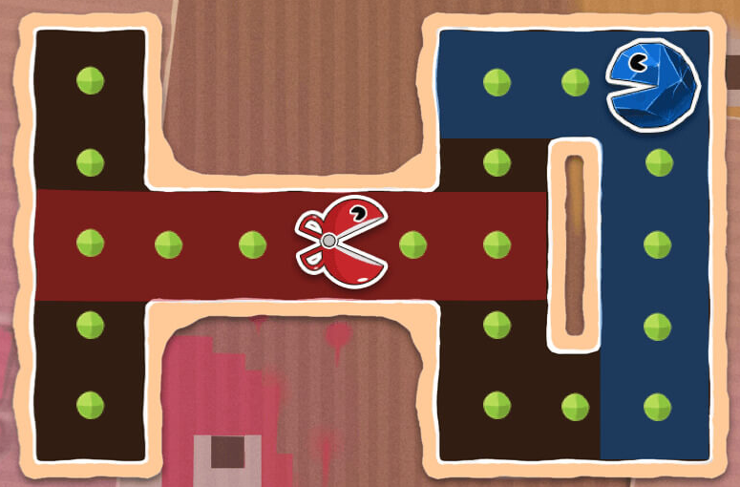
Description of the Environment
Partially Observable
Deterministic (Strategic)
Sequential
Our pacmans have vision on pellets and enemies connected by a continuous straight line. Super-pellets can be seen from everywhere.
Each decision made by our agents determines next steps.
Each decision depends on the previous ones and has effect on the next ones. Each turn is not episodic.
Dynamic
Discrete
Multiagent
Even if the grid does not change and the pallets do not move, our actions and opponents actions change the condition of the play and pellets count.
It is available a finite number of possible decisions, perceptions and actions.
We control a number of pacs between 2 and 5 against the same number of opponents.

Slide 8

At each turn, we have information regarding the visible pacs and pellets.
For each pac, we have its identifier, whether it's ours or not and its coordinates.
Each pac has access to two abilities (SWITCH and SPEED) with the same cooldown period of 10 turns.
Or it can MOVE to the target position
Description of the Agent

Slide 9
The approach adopted

Slide 10

1° step:
BRAINSTORMING
We started our approach by sharing ideas, main goals and possible strategies to apply.
Analyze the game
Analyze the possible situations
Be specific
We wrote everything down on paper, writing in natural language.

Slide 11
2° step: MODELING
We modeled the World in a Diagram Class
Direction
Pacman
Cell
Game Manager
Pellet
Map

Slide 12
3° step: BUILD A SCHEMA - Finite State Machine
q0
q1
q2
Initial State
MOVE
Observe and Choose
q3
q4
q6
q9
q11
Pac Collision
No Visible Pellets Around
Enemy Collision
I can change shape
Tie or loss
q8
q10
q5
q7
Both can not change shape
Win without change shape
Explore
Both can change shape
q14
q12
SPEED
q13
Win
q15
SWITCH
WAIT

Slide 13
A CYCLIC APPROACH
New situation appears in the play
Abstract the situation
Add it in the general schema
Write the appropriate code
1
2
3
4

Slide 14
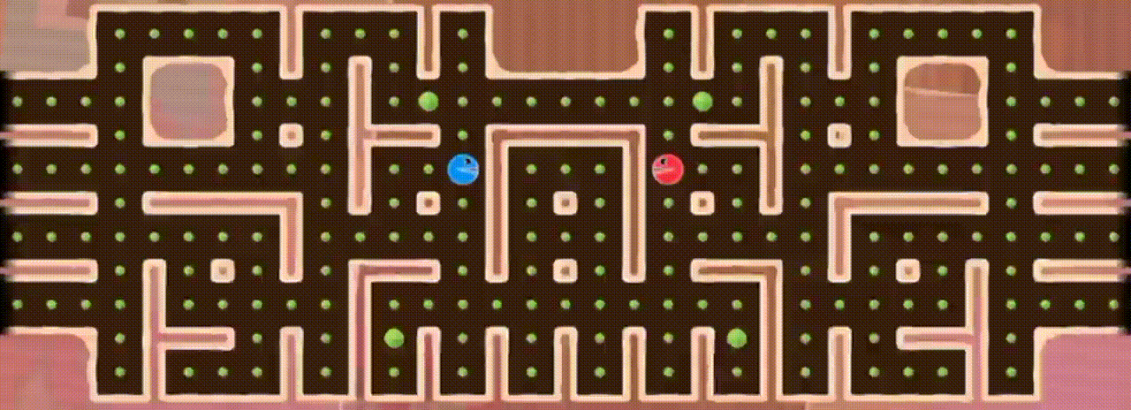
Implementation

Slide 15
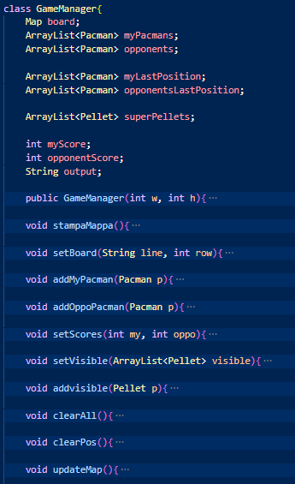
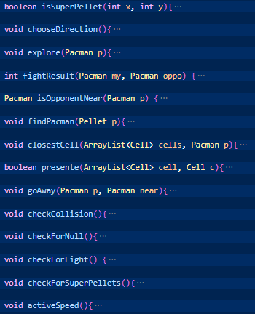
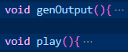
Game Manager
FIELDS
UTILITY
SETUP
MAIN CORE

Slide 16
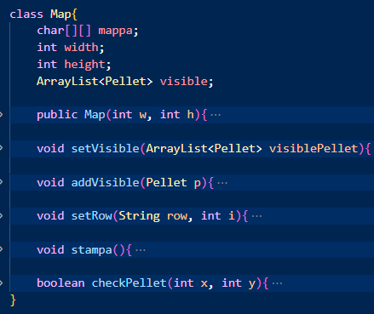
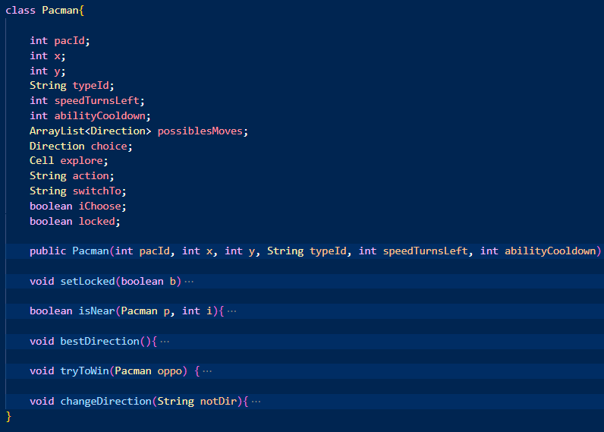
Pacman & Map

Slide 17
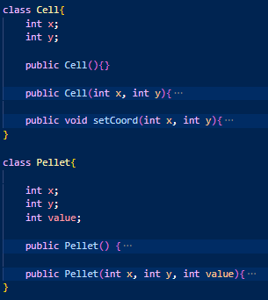
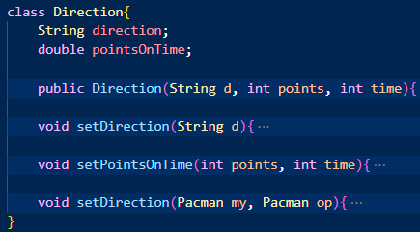
Cell, Direction & Pellet

Slide 18
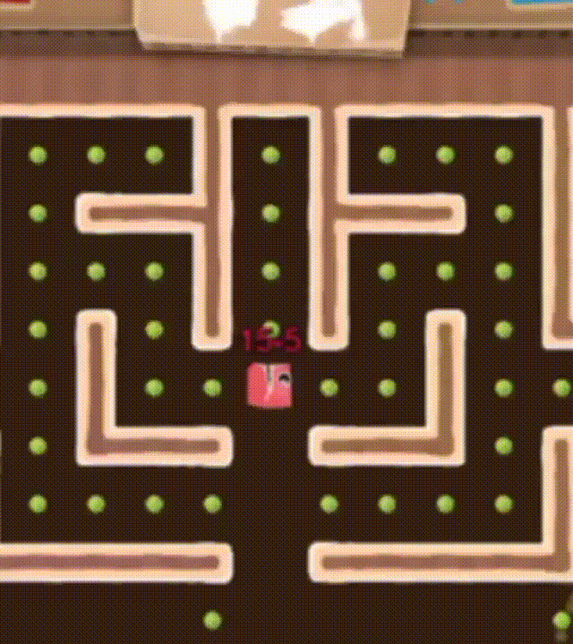
Manage the movement
MOVE pacId X Y
For the Wood leagues, we fixed a target position to our player. The target was the closest SuperPellet or the closest Pellet.
The distance(x,y) method simply returns the distance between two points in a cartesian plane.
For the Bronze and Silver leagues, we fixed a direction to our players. It can move or explore according to this direction.
We chose a different approach because the player has a different perception of the environment. It can see only up and down its y and left and right its x.
The player chooses its best direction by observing the possible directions and then it calculates the best according to the ratio between points over time.
Otherwise, if there are no points around it, the player will explore an unvisited cell.

Slide 19
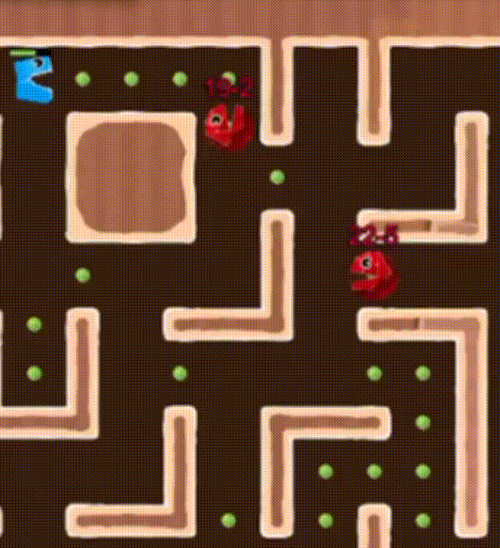
Manage New Skills
SWITCH
SPEED
SWITCH pacId pacType
With pacType equal to: - SCISSORS - ROCK - PAPER (- DEAD in the Silver level)
SPEED pacId
Allows a pac to move by 2 steps instead of 1 during the next 5 turns.

Slide 20
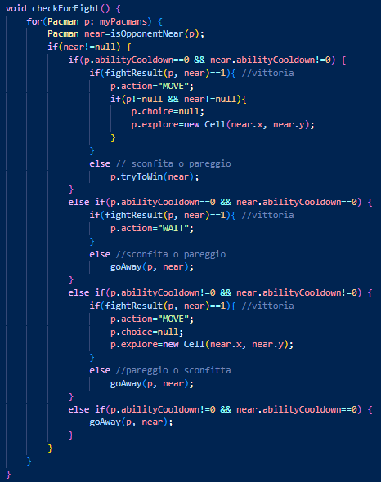
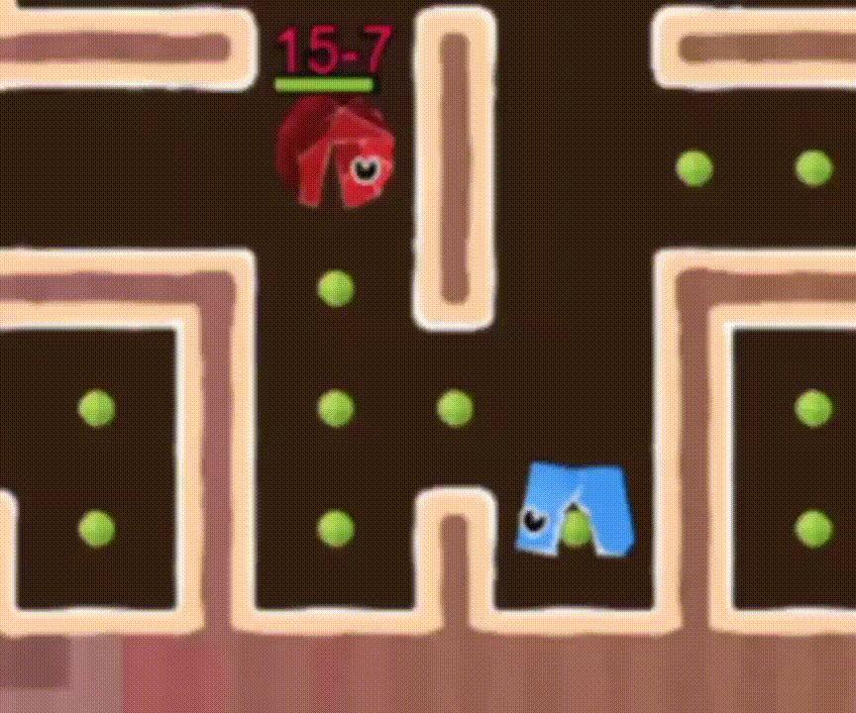
How to activate the SWITCH
I can switch
If I win -> MOVE to the enemy
If I lose -> SWITCH
If it is a tie -> SWITCH
Both can switch
If I win -> WAIT
If I lose -> goAway()
If it is a tie -> goAway()
Nobody can switch
If I win -> MOVE to the enemy
If I lose -> goAway()
If it is a tie -> goAway()
Opponent can switch
In any case -> goAway()

Slide 21
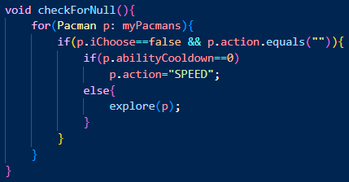
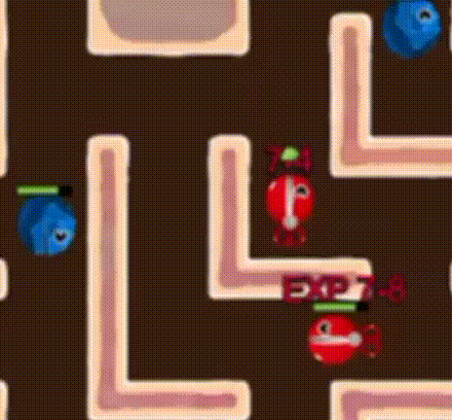
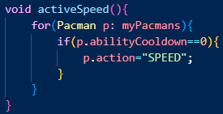
How to activate the SPEED
We decided to activate the SPEED ability when the pacman explores, in order to quickly get new points.
But, in the Silver League, we noticed that the Boss intelligence always actives the SPEED. So we adapted our strategy.
EXPLORE
Silver League

Slide 22
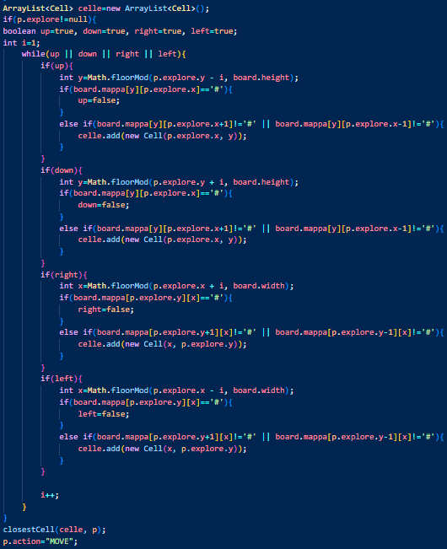
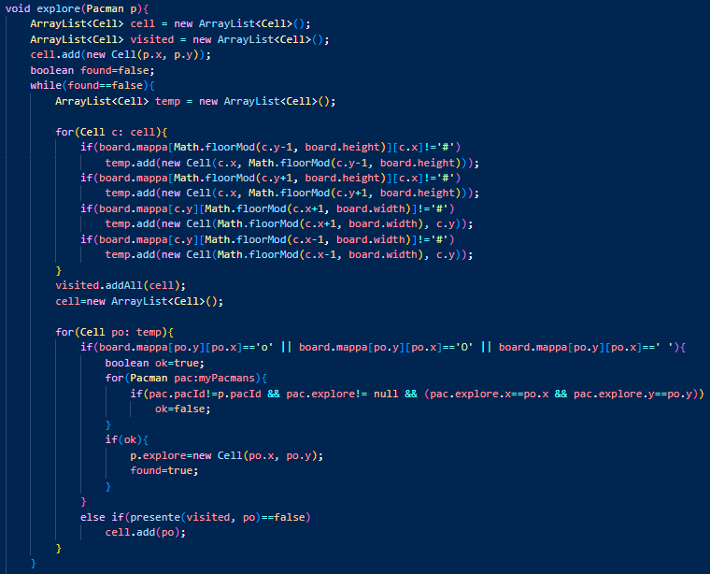
How works the method explore(Pacman p)
Check adjacent cells
Check if the cell to explore is already visited
This second part check in an iterative way if there is a cell that allows us to see in advance the explorable cell

Slide 23
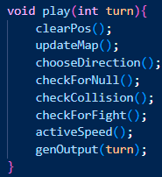
The strategy core
The method play() is the main core of our strategy.
It is the implementation of our finite state machine described previously.
Thanks to this method it is possible to have a clear vision of our chosen strategy.

Slide 24
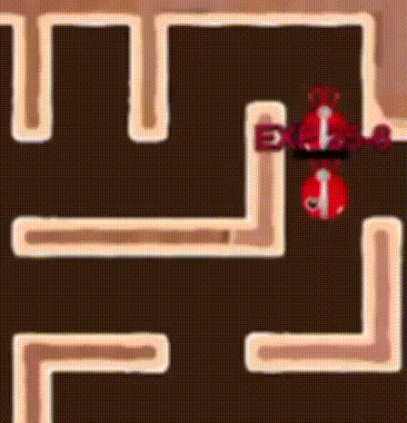
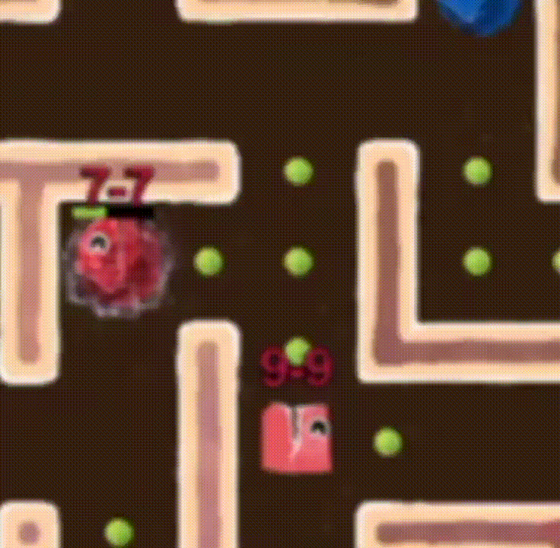
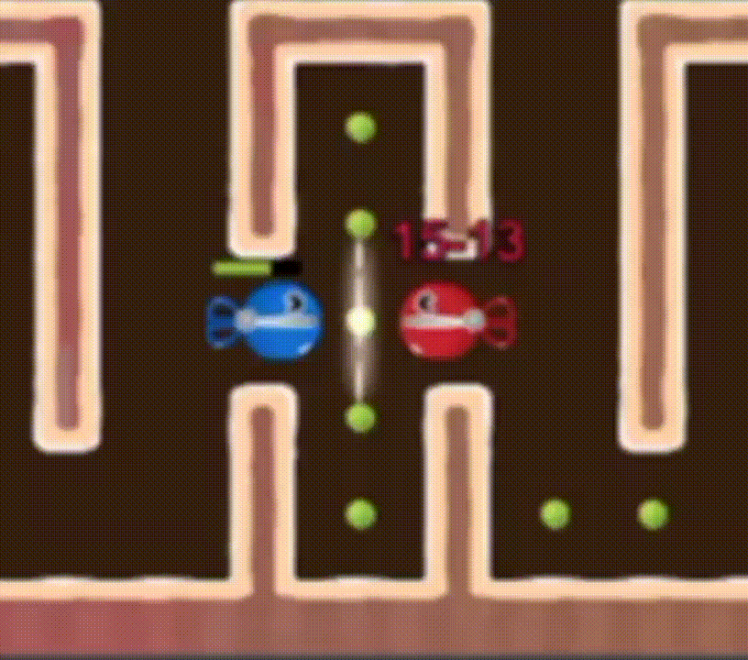
Manage Collision
With our Allies
With Enemies
While Exploring
Otherwise both pacs will be locked in a loop.
With the same type.
Otherwise pacs can explore the same cells.

Slide 25
Strengths and Weakness
Collision Management
Switch strategy
The good world modeling
The exploration is still not optimized
Grids without tunnels represent a difficulty for our strategy
Super Pellets are not our target and often for then we do not reach enough score

Slide 26
Other Criticism
To our code:
Not high level of generalization
To the challenge environment:
By reaching the Silver League the Switch strategy is not more used because of the ability SPEED is broken

Slide 27

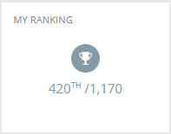

CONCLUSION - OUR RESULTS
Result
League

Slide 28
RESOURCES
Online
Text Book
Practice AI, Pathfinding and Multi-agent with "Spring Challenge 2020"
CodinGame
CodinGame Profile - MiMaCh System
github.com - MiMaCh-System-Proj - final competition
Intelligenza artificiale. Un approccio moderno. Vol. 1 - Stuart J. Russell - Peter Norvig - - Libro - Pearson - | IBS

Slide 29


Thanks!
MiMaCh System
Canonco Martina [231874]
Morello Michele [223953]
Passarelli Chiara [223971]
Do you have any questions?

